Slide 1
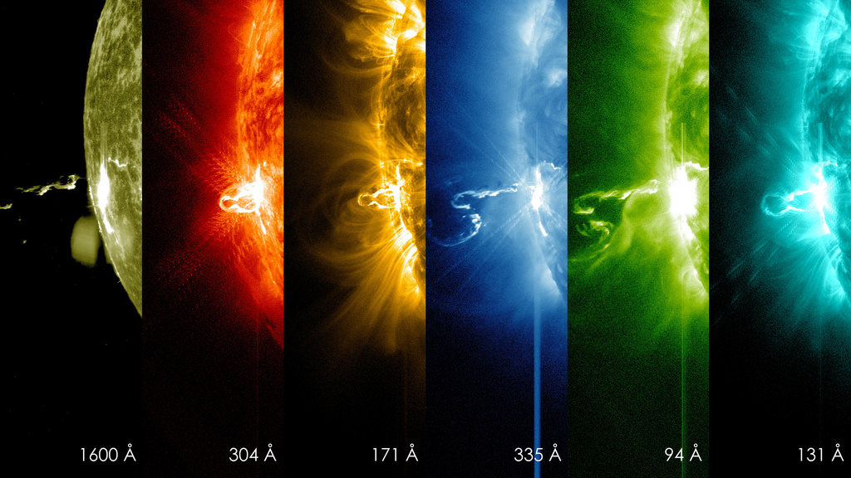
Investigating temperature variations of solar corona during Coronal Mass Ejections
Masters Thesis Presentation On
By
V DHEERAJ SHENOY
USN: 22MSRPH022
Guide
M N Sundar
Co-Guide
Dr. Tanmoy Samanta
Indian Institute of Astrophysics

Slide 2
Table of Contents
Abstract
Introduction
Methodology
Data Analysis
Result

Slide 3
Objective of the study
Understand the temperature variation of solar corona during CMEs
Which temperature plasma shows the most coronal dimming ?
Which temperature plasma shows the fastest recovery to the quiescent state ?
Sun to point source reduction DEM analysis

Slide 4
Introduction
Solar structure
Solar Corona
Filaments/Prominences
Flares
Coronal Mass Ejections (CMEs)
Stellar CMEs
Coronal Dimming
Differential Emission Measure

Slide 5
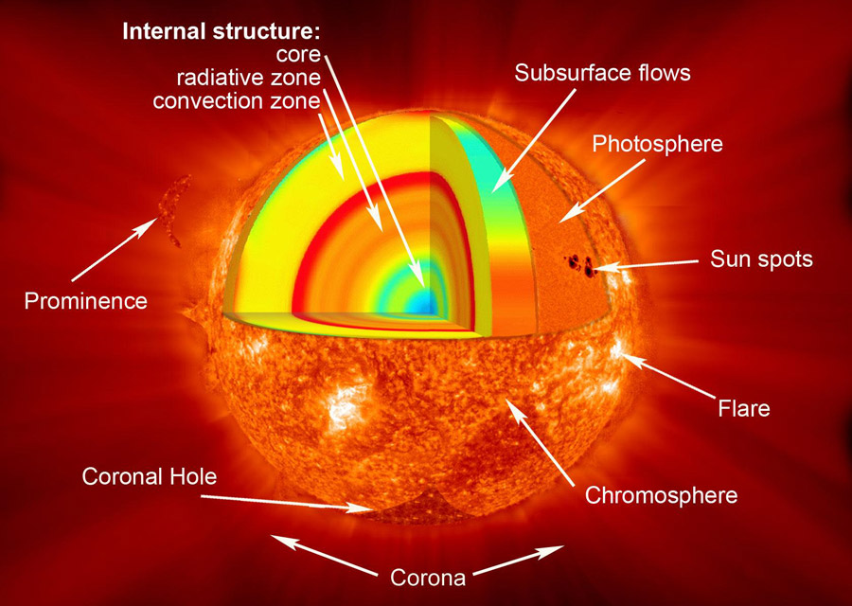
Solar structure
Divided into layers
Interior region
Visible surface
Atmosphere

Slide 6
Solar structure
Interior region
Core
Radiative zone
Convective zone
Visible surface (Photosphere)
Atmosphere (Chromosphere + Corona)

Slide 7
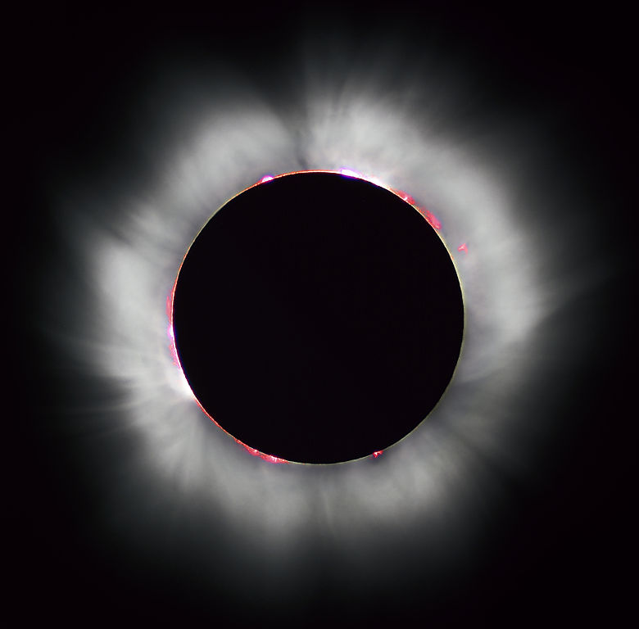
Solar Corona
The outermost layer of the Sun above the chromosphere.
Several million degree Kelvin
Contains forbidden Iron lines (Fe XIV)
Very low density compared to the lower layers

Slide 8
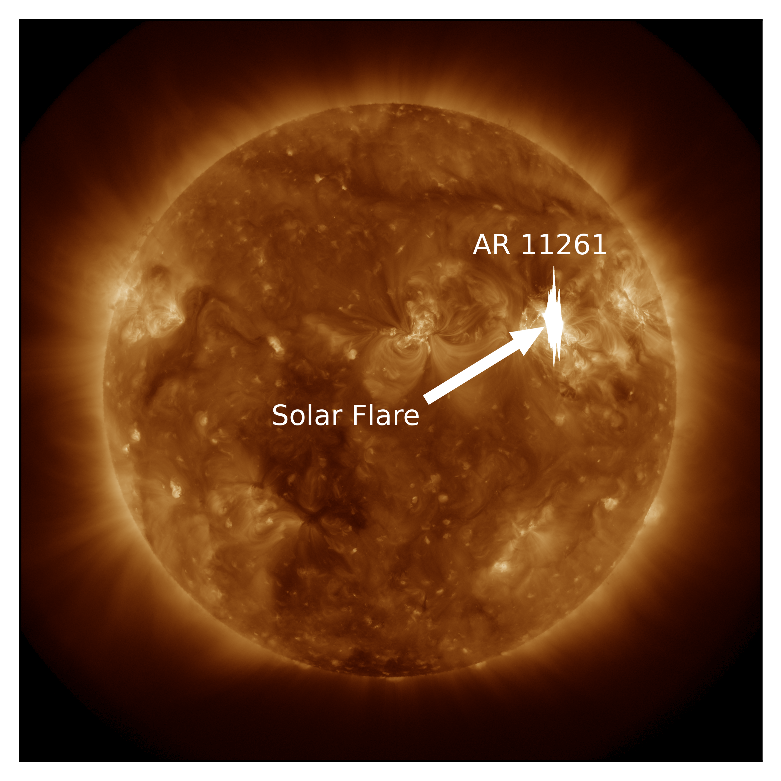
Solar flares
Explosive phenomenons due to magnetic reconnections
Accompanied by filament/prominence eruptions and CMEs

Slide 9
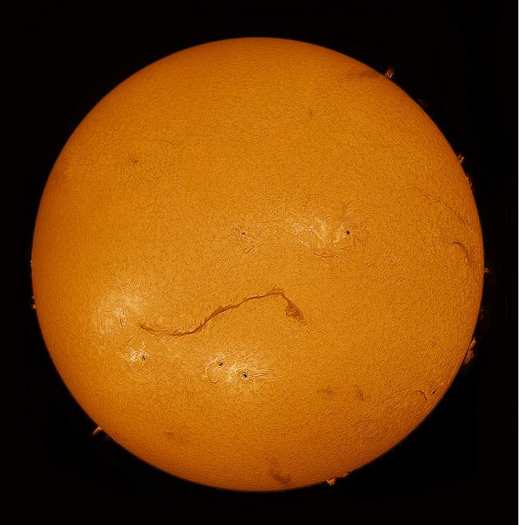
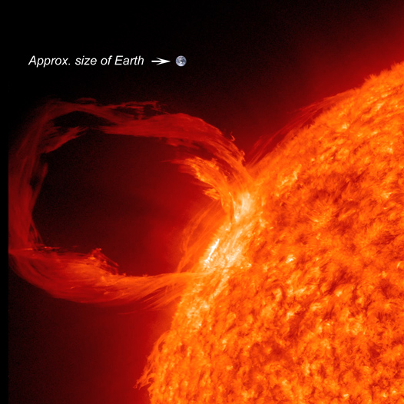
Filaments and Prominences
Filament
Prominence

Slide 10
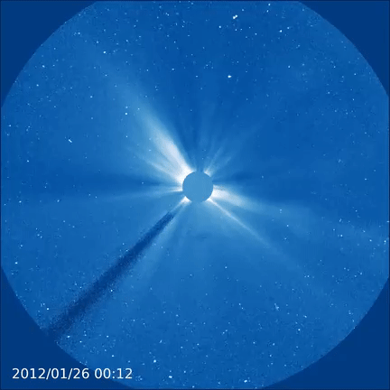
Coronal Mass Ejections
Plasma Ejections
Often associated with flares
Very high association of phenomena of coronal dimming
Affects the space weather, satellite communications etc.
LASCO C3 image of a CME
(Image credit: ESA)

Slide 11
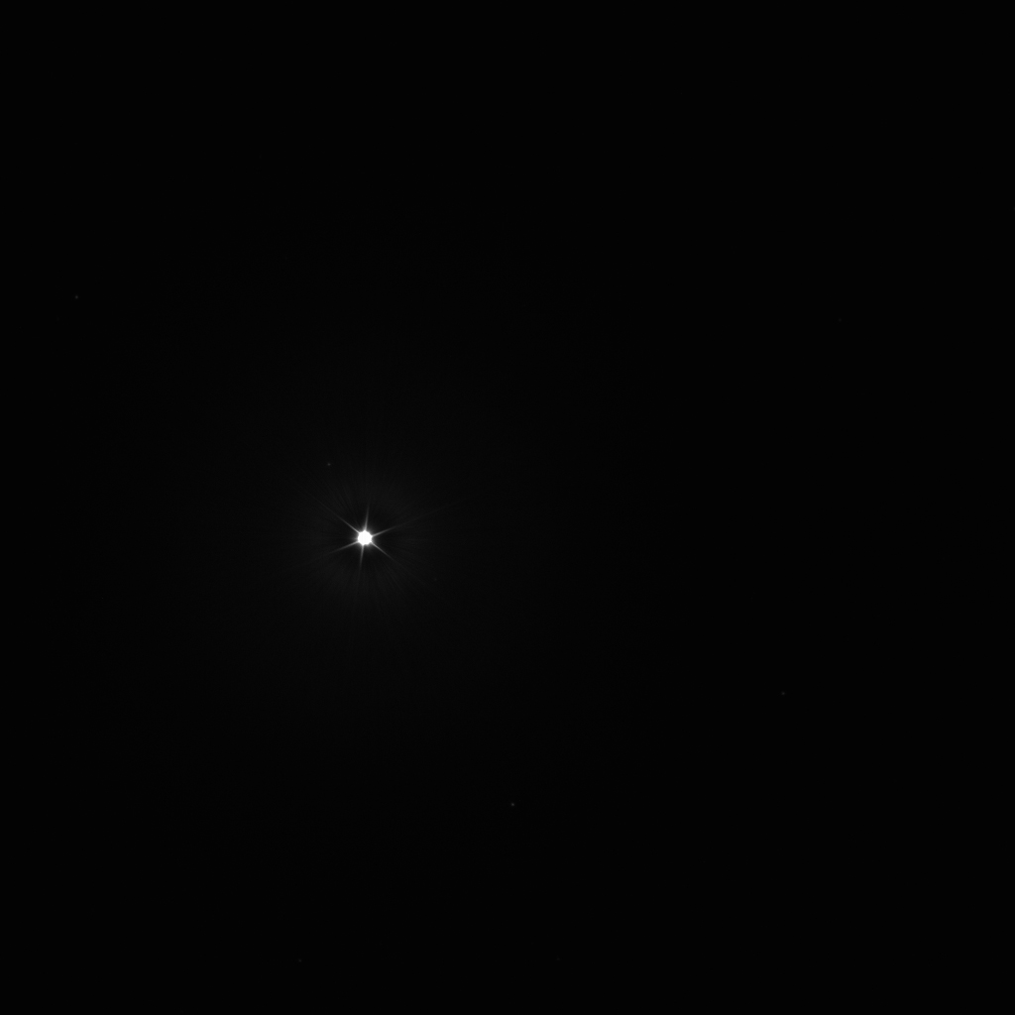
Stellar CMEs
Like solar CMEs
Highly energetic
Difficult to observe
No spatial resolution
Indirect methods to detect stellar CMEs
Coronal Dimming
Blueshifted chromospheric lines
Type-II and Type-IV radio bursts
Point source (star) (Image credit: NASA)

Slide 12
Why understand CMEs?
CMEs from host stars affect exoplanets
Future exoplanet expedition
Understanding space weather

Slide 13
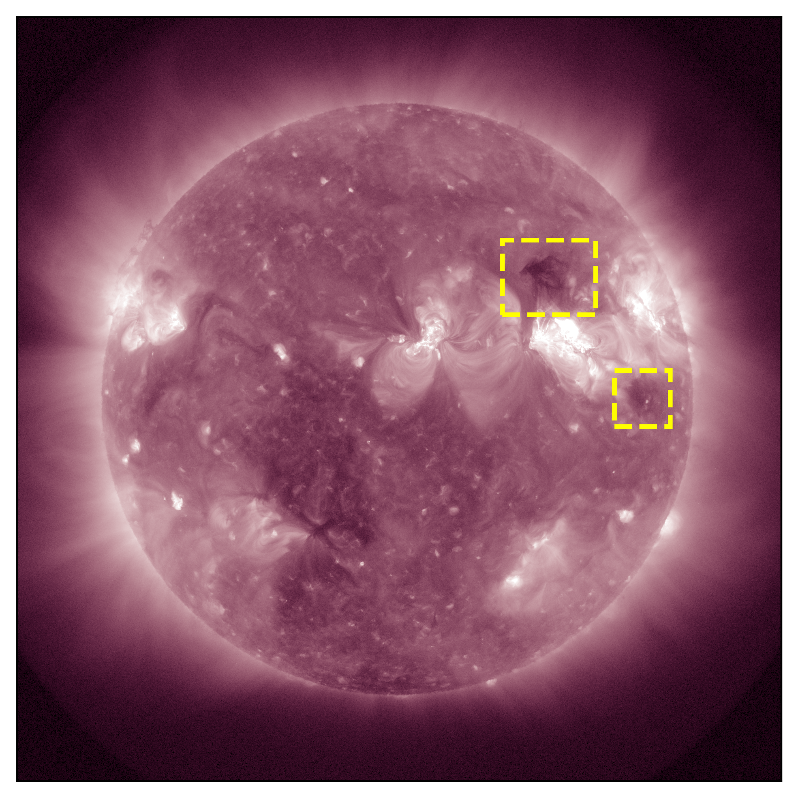
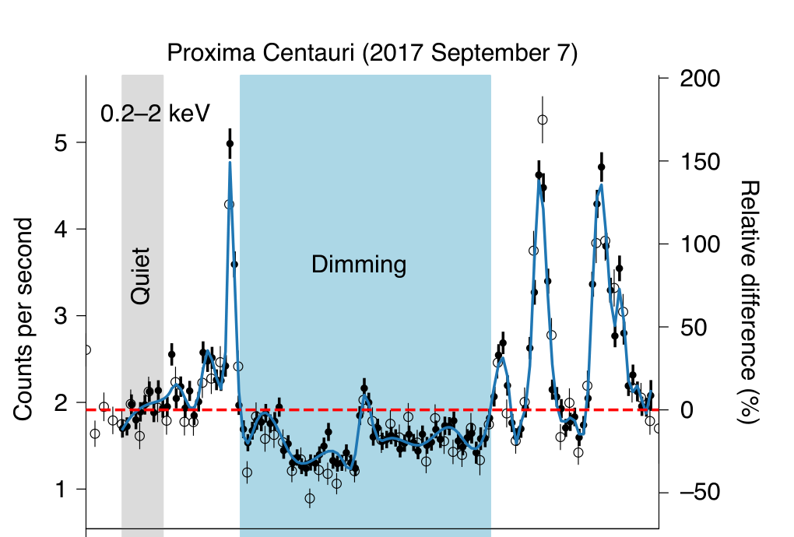
Coronal Dimming
Reduction in the intensity of the light after a CME
Image Credit: (Veronig et al.)
211 Å channel of AIA.

Slide 14
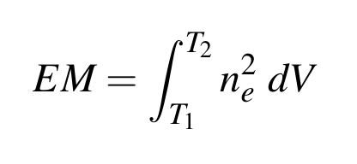
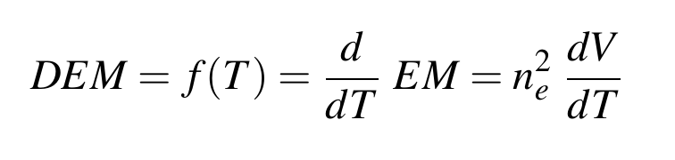
Differential Emission Measure (DEM)
Emission Measure - amount of plasma along the line of sight in a given column of volume V
DEM – emission measure with respect to temperature. Function of temperature

Slide 15
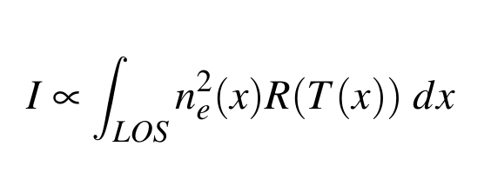
DEM Inversion
Obtain the information about the plasma from the line intensities observed
Similar to a solving a transform equation
We can only approximate the underlying EM profile

Slide 16
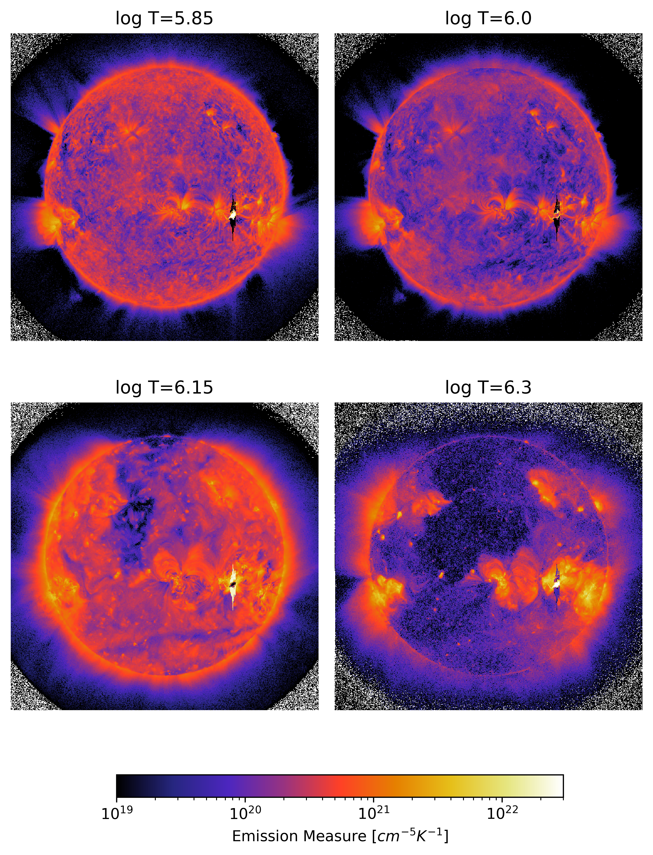
DEM solutions of Sun during the flaring event of August 4th 2011

Slide 17
Methodology
Data of Sun is solved to get the DEM profile.
Convert full disk to a point source: full disk data is converted to a point source (pointification).
Solve the point source for DEM profile.
Compare the DEM curves of full disk and point source.
If CME is associated with dimming, find the maximum dimming temperature region.

Slide 18
Pointification of sun full disk image

Slide 19
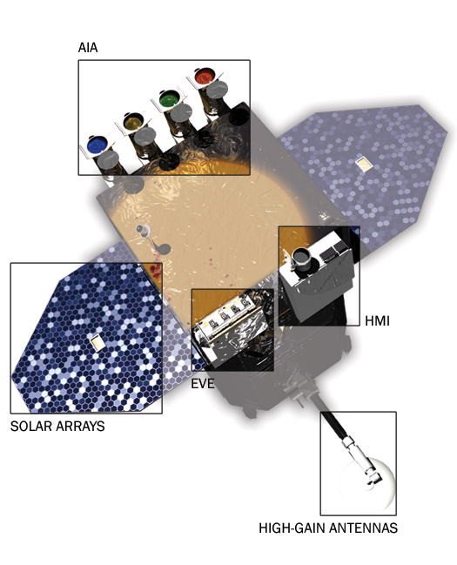
Data
NASA’s SDO/AIA
Three CME event data
Flare associated CME (August 4th 2011)
Long filament eruption associated with a CME (August 31st 2012)
Ground Level Enhancement CME ejection on 21st October 2021
NASA’s SDO Space Observatory

Slide 20
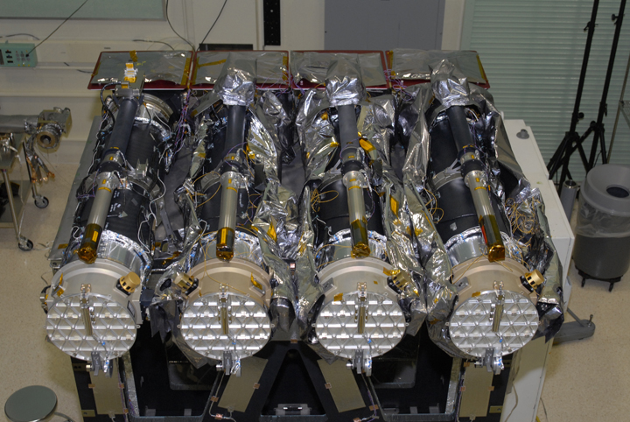
SDO/AIA Telescopes

Slide 21
Results

Slide 22
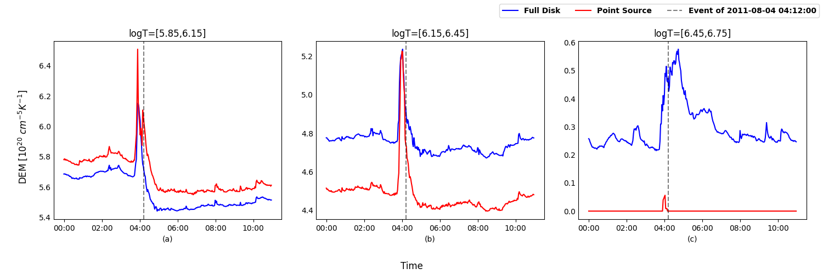
Coronal Dimming
DEM Timeseries of August 4th 2011 CME event

Slide 23
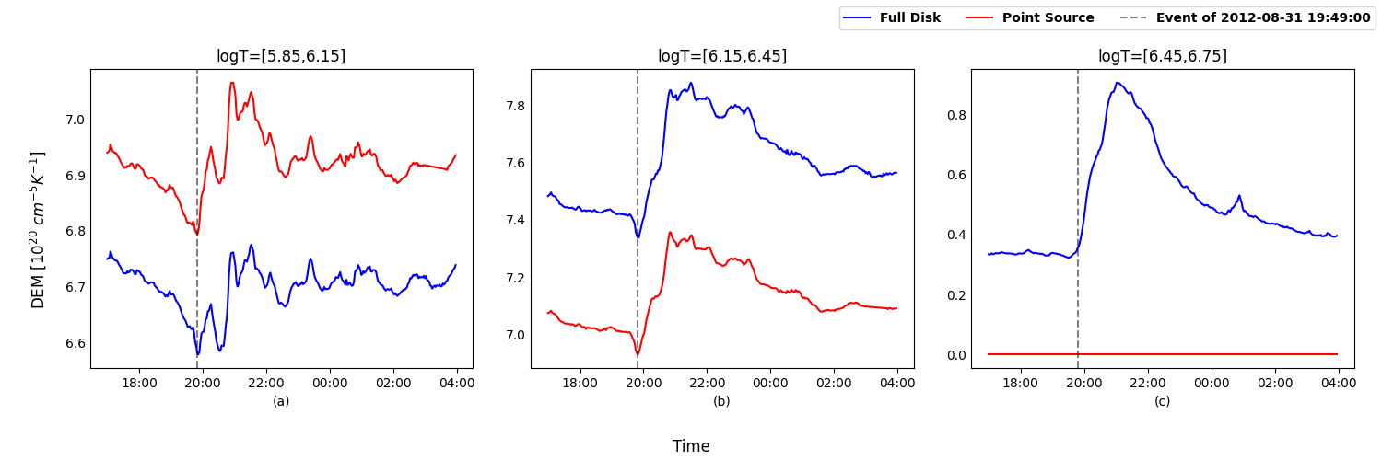
Filament Eruption
DEM Timeseries of August 31th 2012 CME event

Slide 24
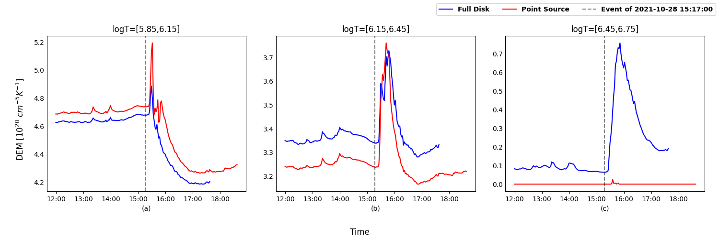
GLE CME event
DEM Timeseries of August 31th 2012 CME event

Slide 25
Summary

Slide 26
Thank you

Slide 27
Data Pre-processing

